Slide 1

2022 Winter
UPDATA AI Study
Chap 5. Markov Decision Process
Image from CS188 of Klein and Abbee

Slide 2
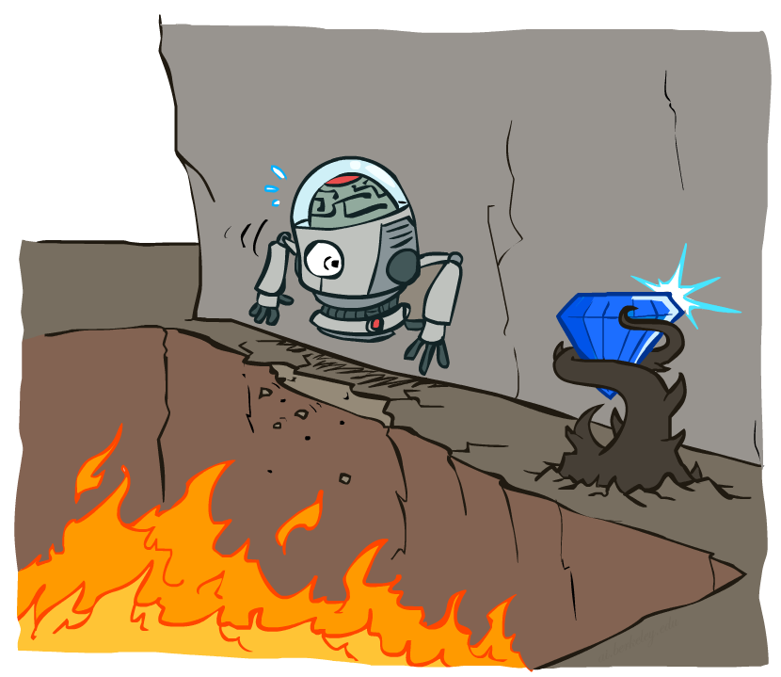
Non-Deterministic Search
Image from CS188 of Klein and Abbee
Notes:
Stochastic vs. deterministic (vs. Non-deterministic)
변수나 프로세스가 deterministic하다는건 같은 시퀀스 안의 다음 사건이 지금 현재 사건으로부터 결정된다는 것이다. 그러니까 Stochastic과는 반대의 개념이다. deterministic algorithm은 같은 인풋을 넣으면 항상 같은 결과를 내는 알고리즘이다. 이에 반해 Non-deterministic algorithm은 인풋이 같아도 아웃풋은 다를 수 있다. stochastic variables or process은 아웃풋의 성질때매 deterministic하지 않다. 근데 이때 우리가 stochastic variables or process는 Non-deterministic이라고 해도 될까? 100% 같은 개념은 아니다. Non-deterministic은 오직 결과의 가능성만을 이야기 하기 때문이다. 한마디로 아웃컴과 분산이 중요한 확률(probability)을 이용한 분석에서는 Non-deterministic보다는 stochastic가 확실한 표현이 될 수 있다. stochastic은 확률이 정량화(quantified)되는데 반해 Non-deterministic는 확률적 개념이 들어있지 않다.

Slide 3

Example: Grid World
A maze-like problem
The agent lives in a grid
Walls block the agent’s path
Noisy movement: actions do not always go as planned
80% of the time, the action North takes the agent North (if there is no wall there)
10% of the time, North takes the agent West; 10% East
If there is a wall in the direction the agent would have been taken, the agent stays put
The agent receives rewards each time step
Small “living” reward each step (can be negative)
Big rewards come at the end (good or bad)
Goal: maximize sum of rewards
Slide credit: CS188 of Klein and Abbee

Slide 4
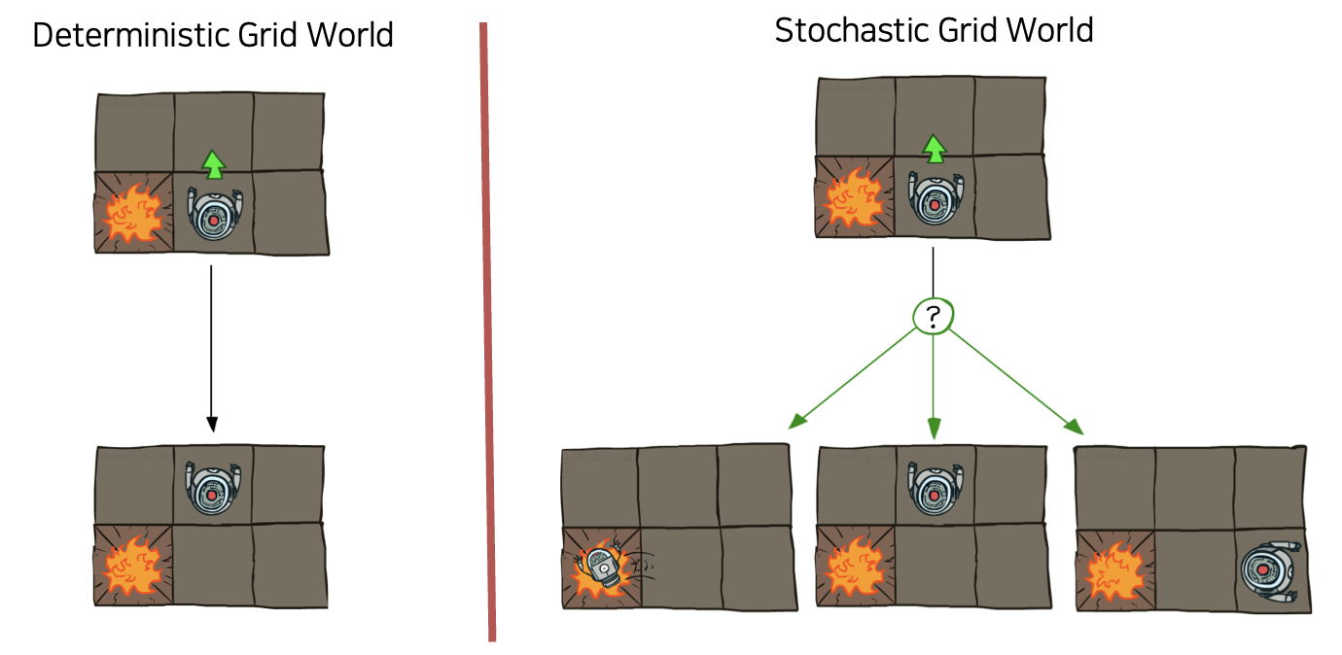
Grid World Actions
Slide credit: CS188 of Klein and Abbee

Slide 5




Markov Decision Process
An MDP is defined by:
A set of states s ∈ S
A set of actions a ∈ A
A transition function T(s, a, s’)
Probability that a from s leads to s’, i.e., P(s’| s, a)
Also called the model or the dynamics
A reward function R(s, a, s’)
Sometimes just R(s) or R(s’)
A start state
Maybe a terminal state
MDPs are non-deterministic search problems
One way to solve them is with expectimax search
We’ll have a new tool soon
Slide credit: CS188 of Klein and Abbee

Slide 6
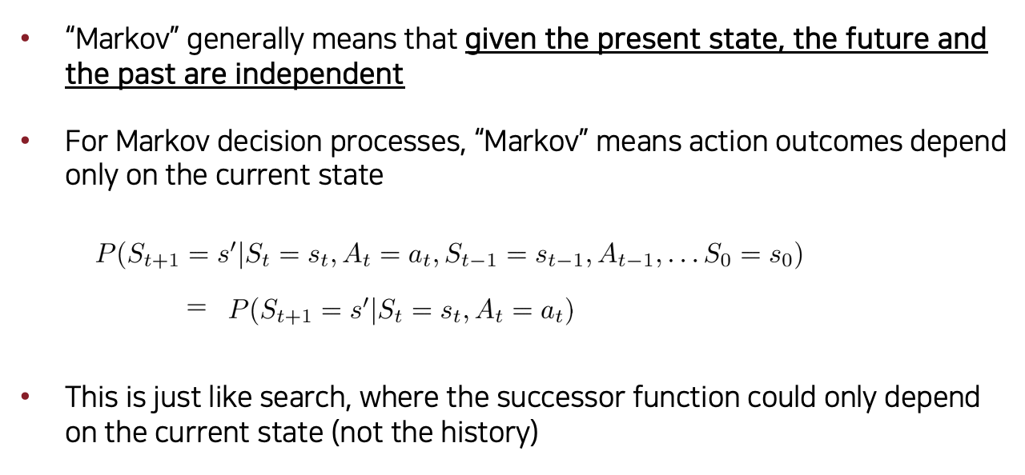
What is Markov about MDPs?
Slide credit: CS188 of Klein and Abbee

Slide 7

Policies
In deterministic single-agent search problems, we wanted an optimal plan, or sequence of actions, from start to a goal
For MDPs, we want an optimal policy π*: S → A
A policy π gives an action for each state
An optimal policy is one that maximizes expected utility if followed
An explicit policy defines a reflex agent
Expectimax didn’t compute entire policies
It computed the action for a single state only
Optimal policy when R(s, a, s’) = -0.03 for all non-terminals s
Slide credit: CS188 of Klein and Abbee

Slide 8
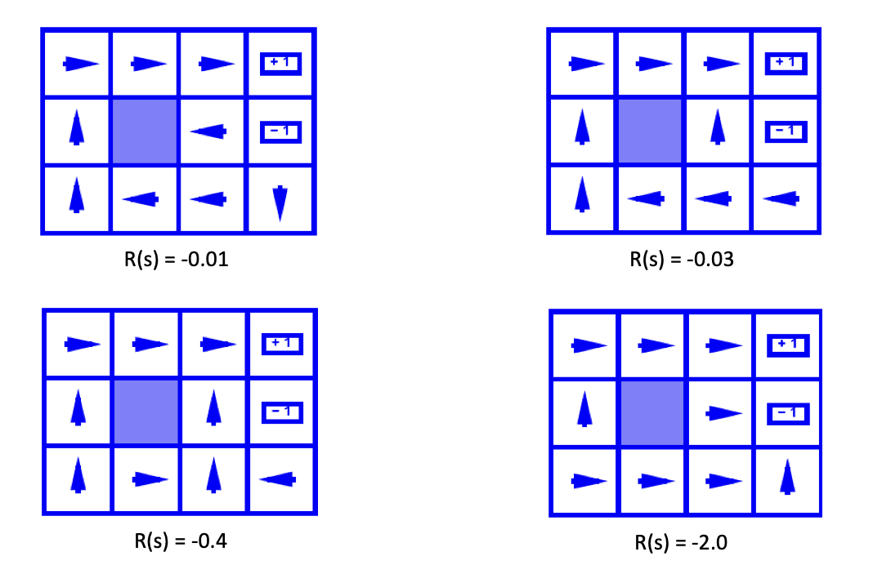
Optimal Policies
Slide credit: CS188 of Klein and Abbee

Slide 9
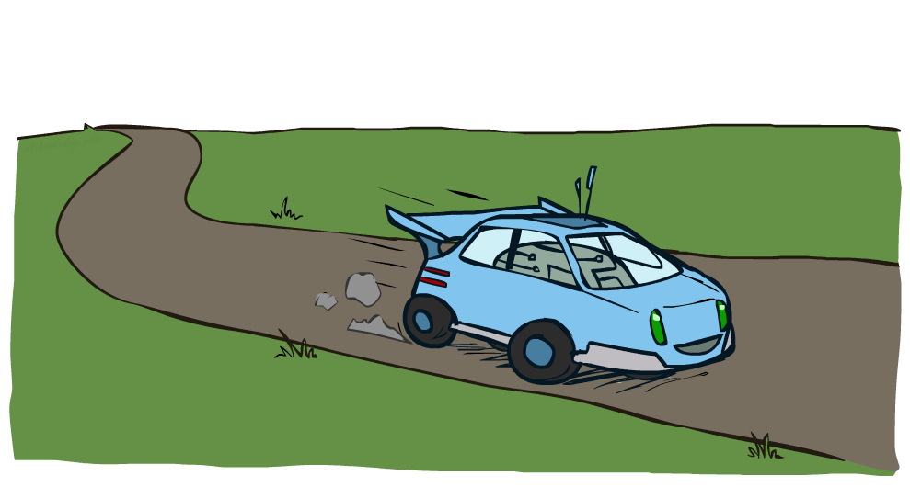
Example: Racing
Slide credit: CS188 of Klein and Abbee

Slide 10
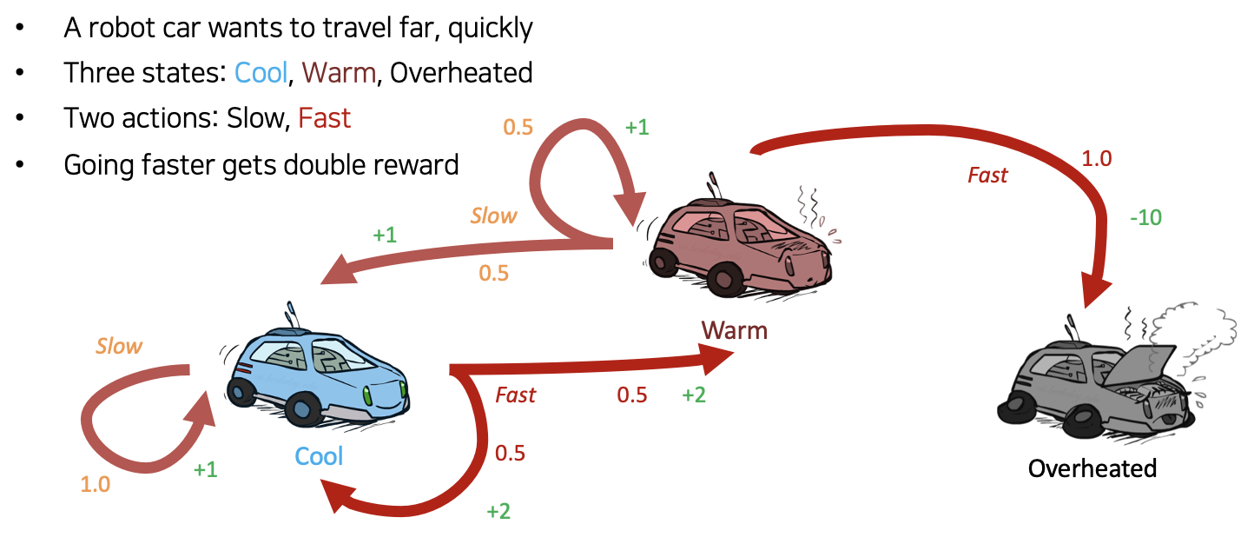
Example: Racing
Slide credit: CS188 of Klein and Abbee

Slide 11
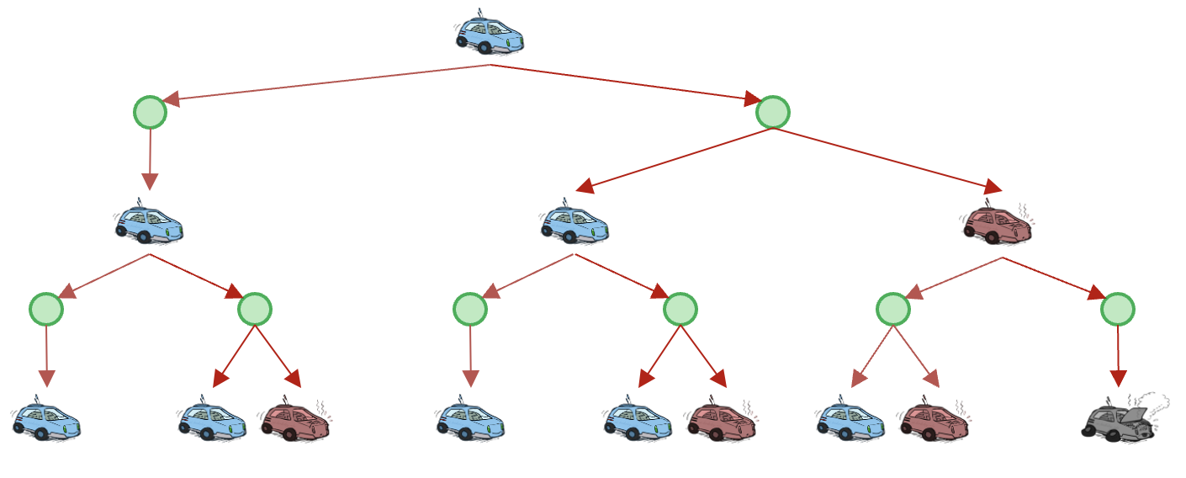
Racing Search Tree
Slide credit: CS188 of Klein and Abbee

Slide 12
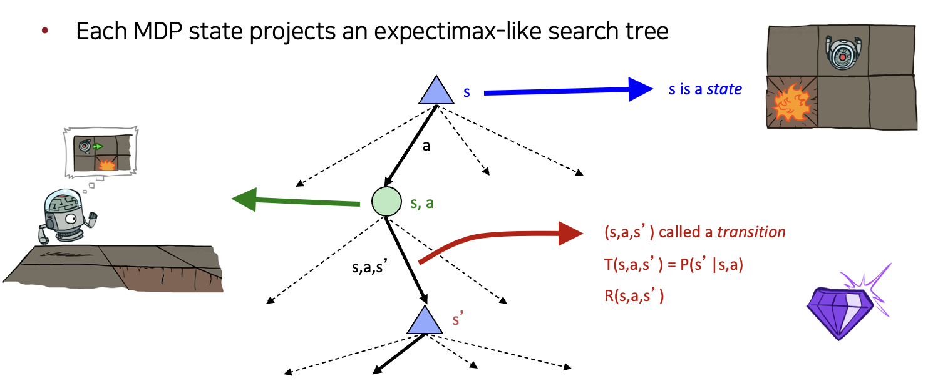
MDP Search Trees
Slide credit: CS188 of Klein and Abbee

Slide 13
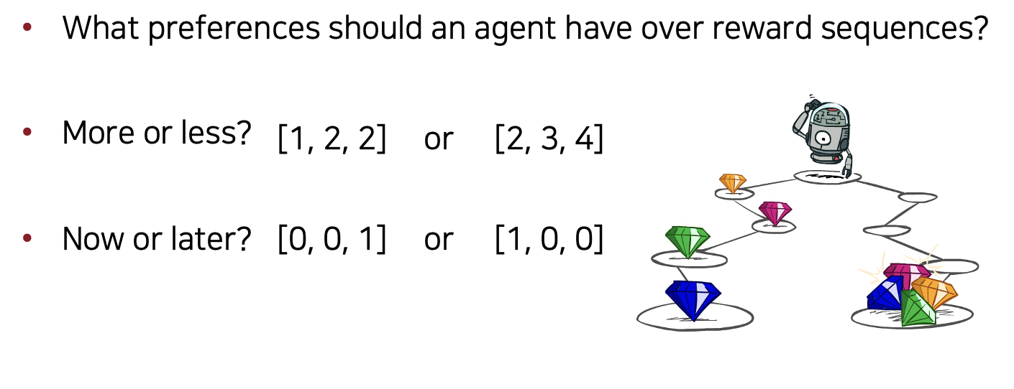
Utilities of Sequences
Slide credit: CS188 of Klein and Abbee

Slide 14
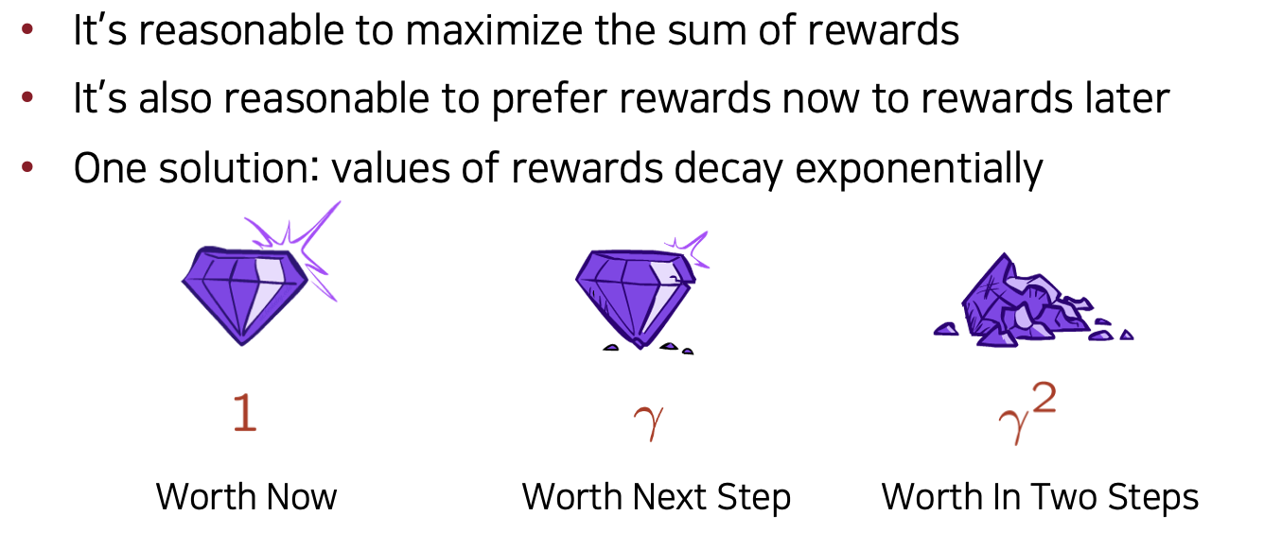
Discounting
Slide credit: CS188 of Klein and Abbee

Slide 15
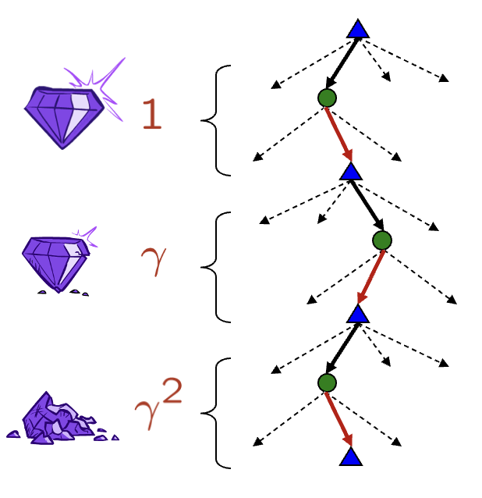
Discounting
How to discount?
Each time we descend a level, we multiply in the discount once
Why discount?
Sooner rewards probably do have higher utility than later rewards
Also helps our algorithms converge
Example: discount of 0.5
U([1,2,3]) = 1*1 + 0.5*2 + 0.25*3
U([1,2,3]) < U([3,2,1])
Slide credit: CS188 of Klein and Abbee

Slide 16
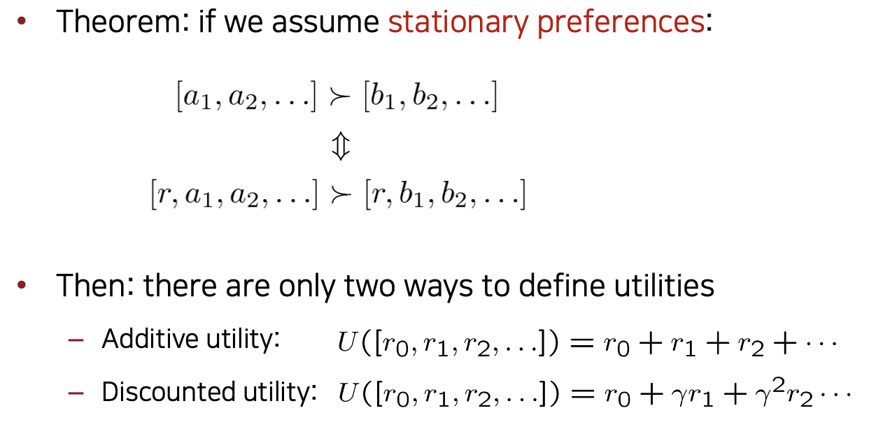
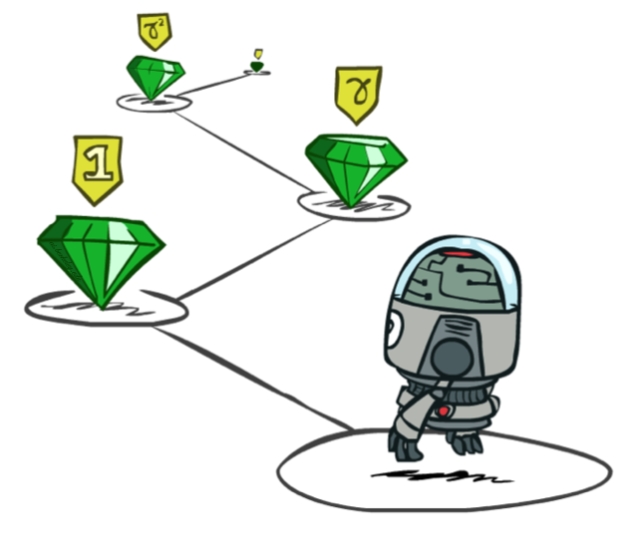
Stationary Preferences
Slide credit: CS188 of Klein and Abbee

Slide 17
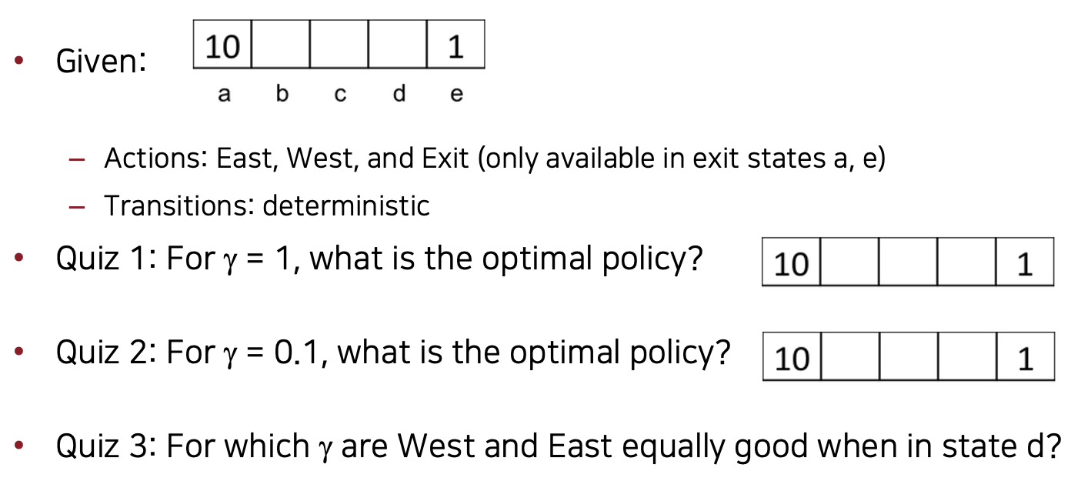
Quiz: Discounting
Slide credit: CS188 of Klein and Abbee

Slide 18
Solving MDPs
Slide credit: CS188 of Klein and Abbee

Slide 19
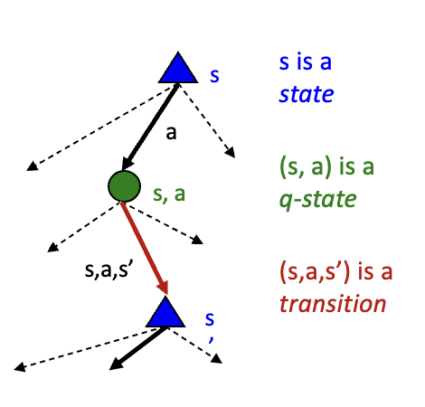
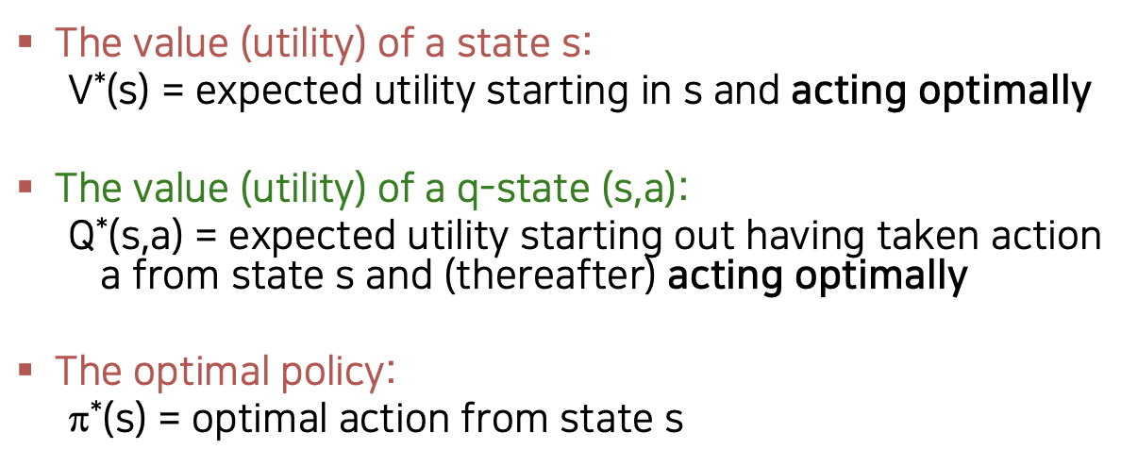
Optimal Quantities
Slide credit: CS188 of Klein and Abbee

Slide 20
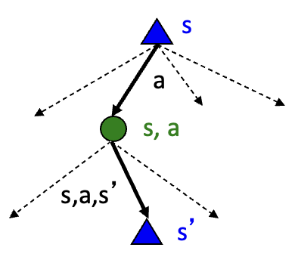


Value of States
Fundamental operation: compute the (expectimax) value of a state
Expected utility under optimal action
Average sum of (discounted) rewards
This is just what expectimax computed!
Recursive definition of value:
Slide credit: CS188 of Klein and Abbee

Slide 21
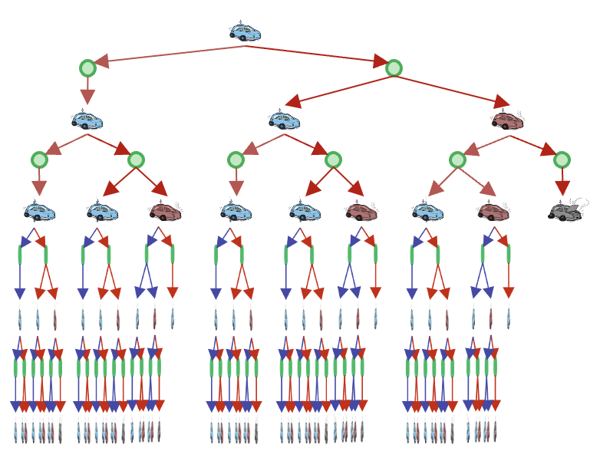
Racing Search Tree
We’re doing way too much work with expectimax!
Problem: States are repeated
Idea: Only compute needed quantities once
Problem: Tree goes on forever
Idea: Do a depth-limited computation, but with increasing depths until change is small
Note: deep parts of the tree eventually don’t matter if γ < 1
Slide credit: CS188 of Klein and Abbee

Slide 22
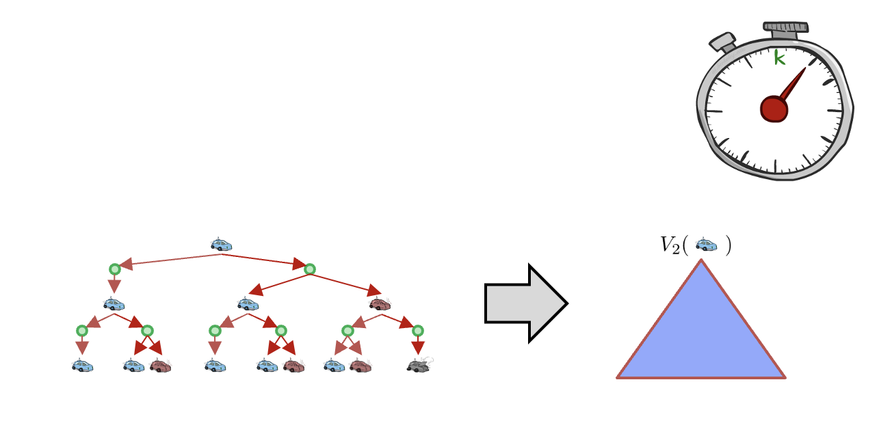
Time-Limited Values
Key idea: time-limited values
Define V_{k}(s) to be the optimal value of s if the game ends in k more time steps
Equivalently, it’s what a depth-k expectimax would give from s
Slide credit: CS188 of Klein and Abbee

Slide 23
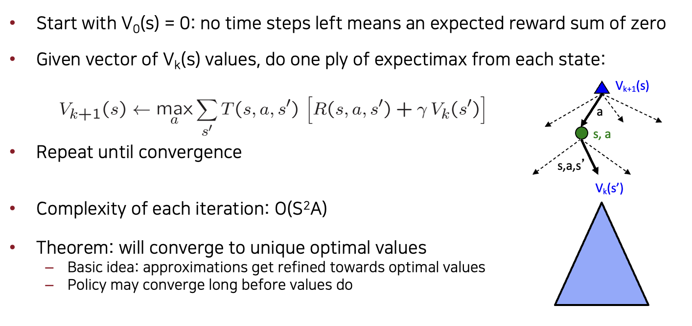
Value Iteration
Slide credit: CS188 of Klein and Abbee

Slide 24
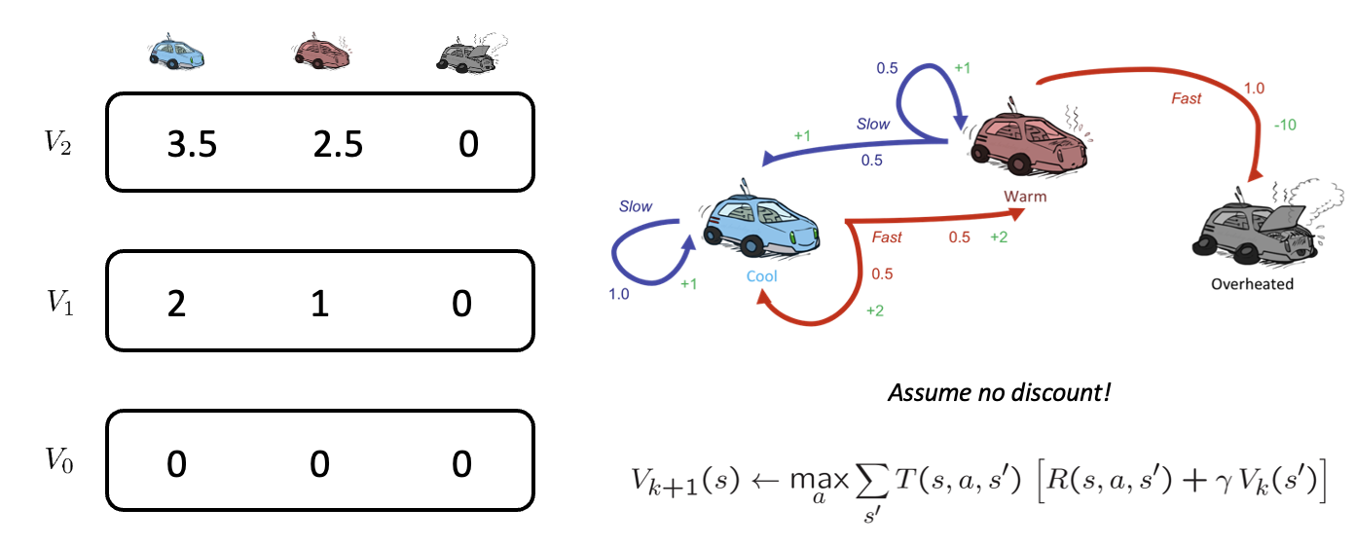
Discounting
Slide credit: CS188 of Klein and Abbee

Slide 25
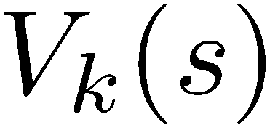
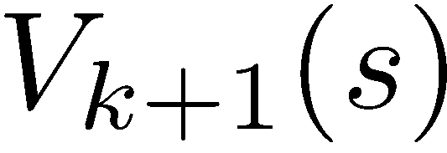
Convergence
How do we know the V_{k} vectors are going to converge?
Case 1: If the tree has maximum depth M, then V_{M} holds the actual untruncated values
Case 2: If the discount is less than 1
Sketch: For any state V_{k} and V_{k+1} can be viewed as depth k+1 expectimax results in nearly identical search trees
The difference is that on the bottom layer, V_{k+1} has actual rewards while V_{k} has zeros
That last layer is at best all R_{MAX}
It is at worst R_{MIN}
But everything is discounted by γ^{k} that far out
So V_{k} and V_{k+1} are at most γ^{k} max|R| different
So as k increases, the values converge
Slide credit: CS188 of Klein and Abbee

Slide 26

Policy Methods
Slide credit: CS188 of Klein and Abbee

Slide 27

Policy Evaluation
Slide credit: CS188 of Klein and Abbee

Slide 28
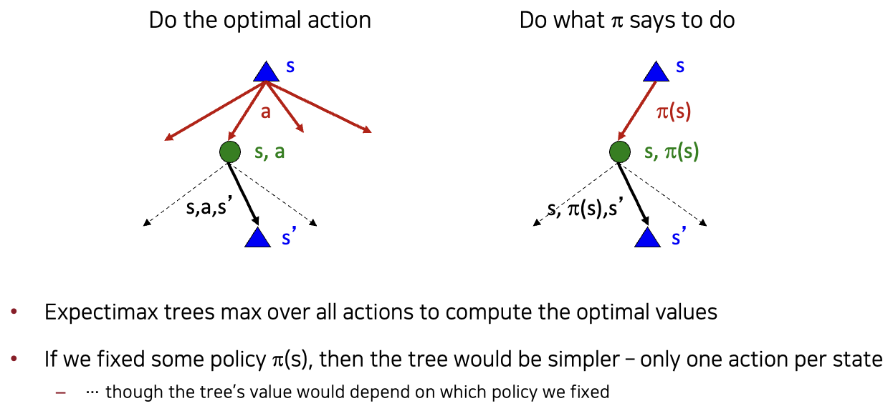
Fixed Policies
Slide credit: CS188 of Klein and Abbee

Slide 29
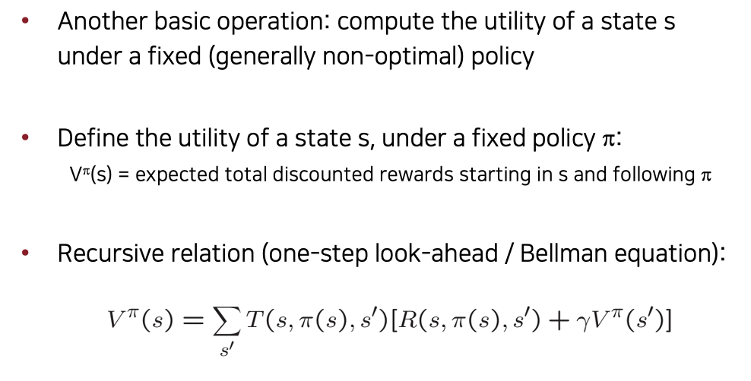
Utilities for a fixed Policy
s
π(s)
s, π(s)
s, π(s),s’
s’
Slide credit: CS188 of Klein and Abbee

Slide 30
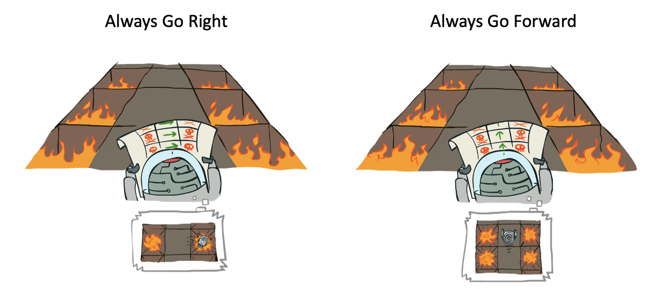
Example: Policy Evaluation
Slide credit: CS188 of Klein and Abbee

Slide 31
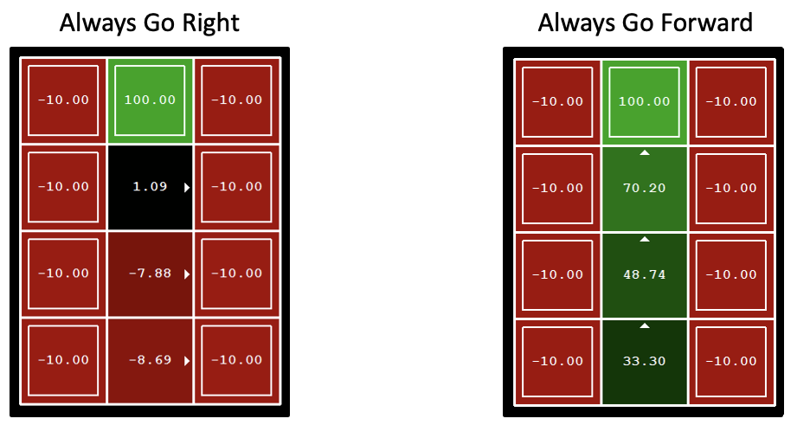
Example: Policy Evaluation
Slide credit: CS188 of Klein and Abbee

Slide 32
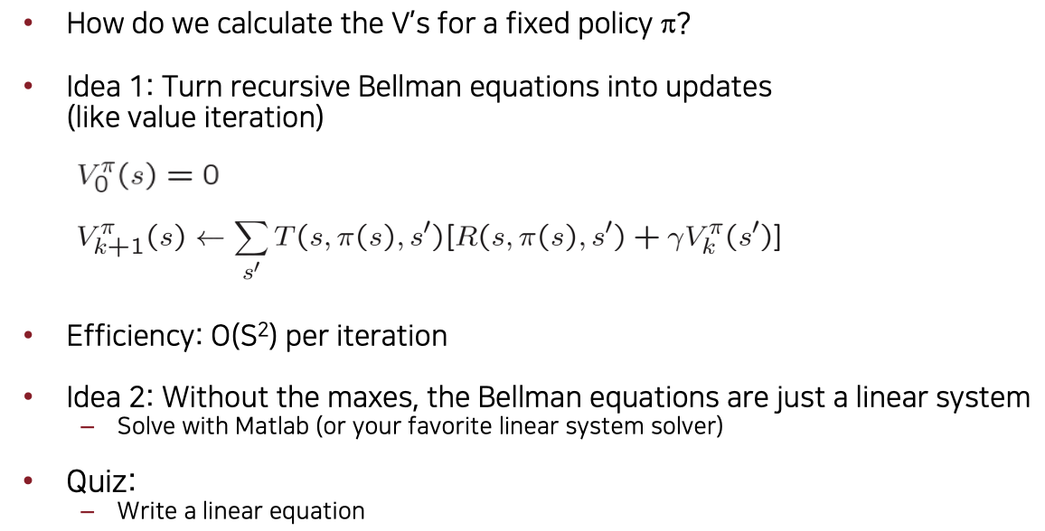
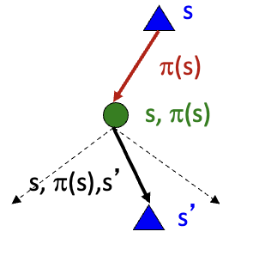
Policy Methods
Slide credit: CS188 of Klein and Abbee

Slide 33
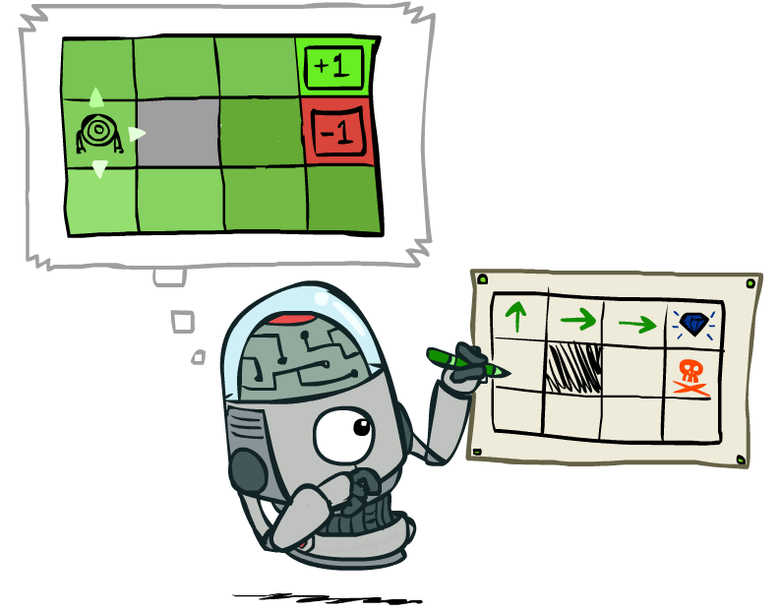
Policy Extraction
Slide credit: CS188 of Klein and Abbee

Slide 34
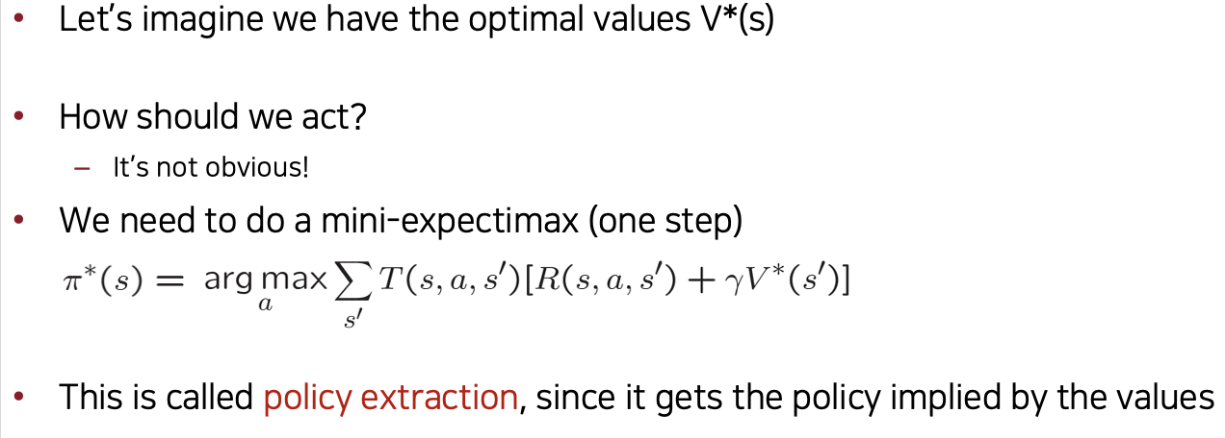
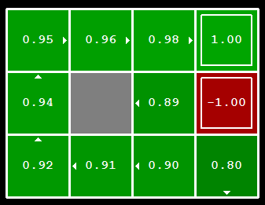
Computing Actions from Values
Slide credit: CS188 of Klein and Abbee

Slide 35
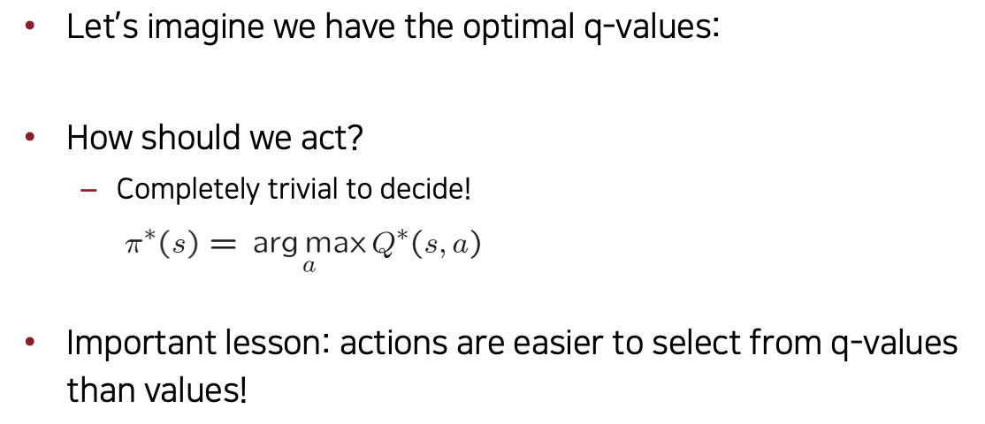
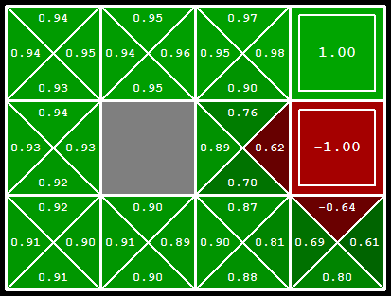
Counting Actions from Q-Values
Slide credit: CS188 of Klein and Abbee

Slide 36

Policy Iteration
Slide credit: CS188 of Klein and Abbee

Slide 37
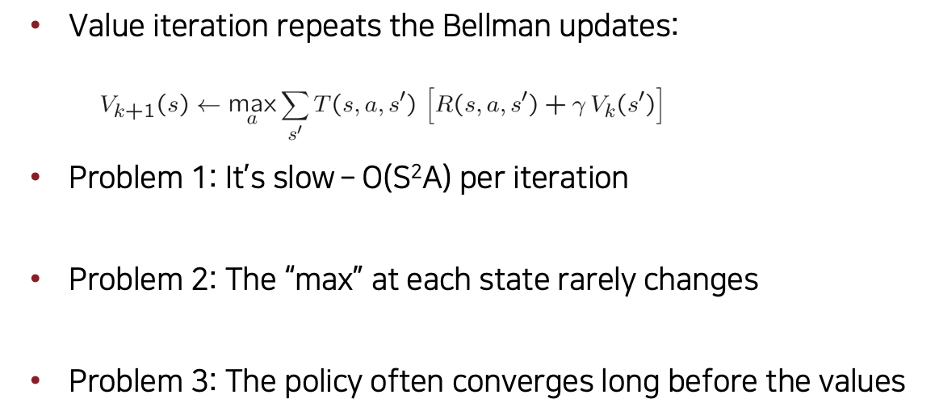
Problem with Value Iteration
s
a
s, a
s,a,s’
s’
Slide credit: CS188 of Klein and Abbee

Slide 38
Policy Iteration
Alternative approach for optimal values:
Step 1: Policy evaluation: calculate utilities for some fixed policy (not optimal utilities!) until convergence
Step 2: Policy improvement: update policy using one-step look-ahead with resulting converged (but not optimal!) utilities as future values
Repeat steps until policy converges
This is policy iteration
It’s still optimal!
Can converge (much) faster under some conditions
Slide credit: CS188 of Klein and Abbee

Slide 39
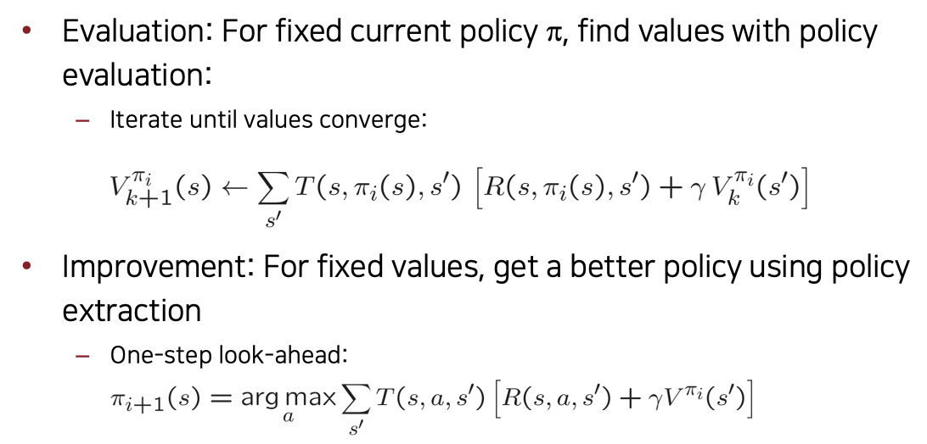
Policy Iteration
Slide credit: CS188 of Klein and Abbee

Slide 40
Comparison
Both value iteration and policy iteration compute the same thing (all optimal values)
In value iteration:
Every iteration updates both the values and (implicitly) the policy
We don’t track the policy, but taking the max over actions implicitly recomputes it
In policy iteration:
We do several passes that update utilities with fixed policy (each pass is fast because we consider only one action, not all of them)
After the policy is evaluated, a new policy is chosen (slow like a value iteration pass)
The new policy will be better (or we’re done)
Both are dynamic programs for solving MDPs
Slide credit: CS188 of Klein and Abbee

Slide 41
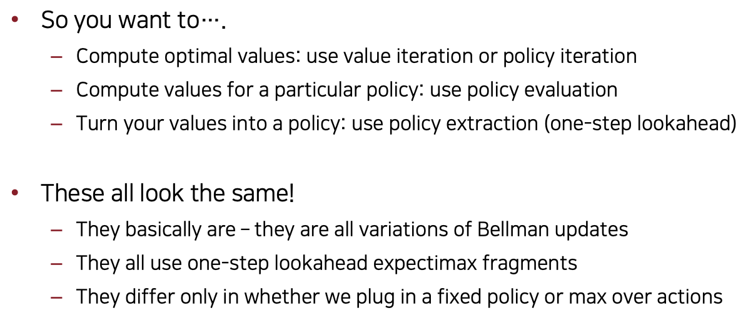
Summary: MDP Algorithms
Slide credit: CS188 of Klein and Abbee

